Slide 1
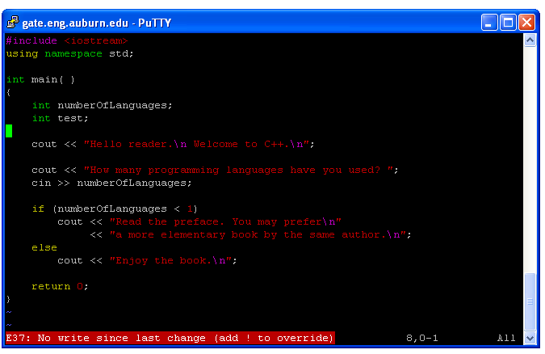
FAQ: Exit Vi Using :q
Can NOT exit with “:q” if you have not use “:w” to write changes.

Slide 2
FAQ: Linux Users
Install two operating systems (i.e., Windows and Linux on your PC)
Virtual Machines. (e.g., VirtualBox; VMWare)
VirtualBox is running on Windows; Install Linux (e.g., Ubuntu in VirtualBox)

Slide 3
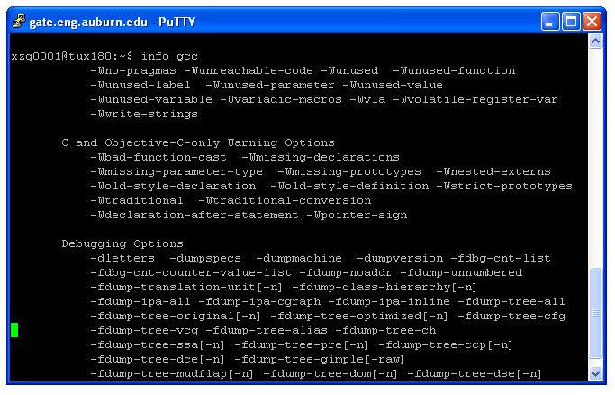
Learn More About g++: info g++

Slide 4
COMP 2710 Software Construction
C++ Basics
Dr. Xiao Qin
Auburn University
http://www.eng.auburn.edu/~xqin
xqin@auburn.edu
Spring 2012
These slides are adapted from notes by Dr. Walter Savitch (UCSD)

Slide 5
C++ Variables
C++ Identifiers
  Keywords/reserved words vs. Identifiers
  Must start with a letter or the underscore symbol
  The rest must be letters, digits, or the underscore symbol
  Case-sensitivity and validity of identifiers
  Meaningful names! (see also Page 13)
Variables
  A memory location to store data for a program
  Must declare all data before use in program
1-<number>

Slide 6
C++ Variables - Examples
X, x, abc, _yyy, TBL123, sum, count, RATE
Which identifiers are poor choices for us?
Why?
76, 9B, %Percent, time-2, firstprog.c, main.cpp
Which identifier will be rejected by the compiler?
Why?
1-<number>
Notes:
Please read ch 1.2 on page 7
The first five.
Not descriptive
All are rejected.

Slide 7
C++ Variables - Examples (cont.)
Are STUDENT, student, and Student three distinct identifiers?
Why?
1-<number>
Notes:
Yes.
C++ is case-sensitive

Slide 8
Keywords
Reserved Words
Predefined meaning in C++
Example:
  short, long, char,
  true, false,
  if, else, for, while, class,
  private, public,
  typedef, static, sizeof,
  new, delete,
See Appendix 1 for a complete list of keywords.
1-<number>
Notes:
Yes.
C++ is case-sensitive

Slide 9
Declare a Variable
A variable must be declared before it is used!
Tell the compiler what kind of data (i.e., data type) will be stored in the variable
See what will happen when you compile a C++ program where a variable is not declared.
1-<number>
Notes:
Give an example.

Slide 10
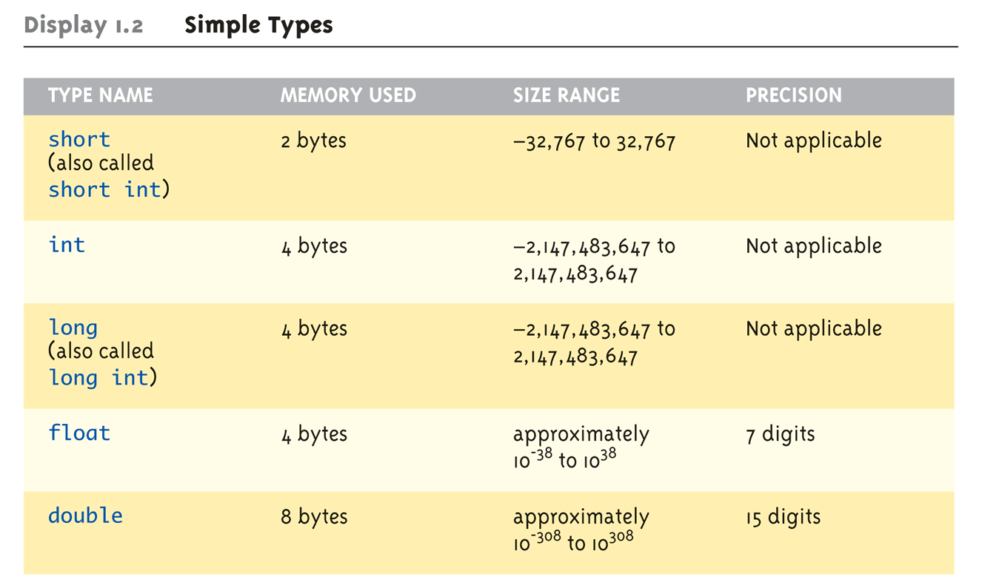
Data Types:
Display 1.2 Simple Types (1 of 2)
Copyright © 2008 Pearson Addison-Wesley. All rights reserved.
1-<number>
Notes:
Page 9:
Short -32767 to 32767 = 65534 = 2^16 -> 16 bits for 2 Bytes -> 8 Bits per Byte
double: commonly used floating-pint number

Slide 11
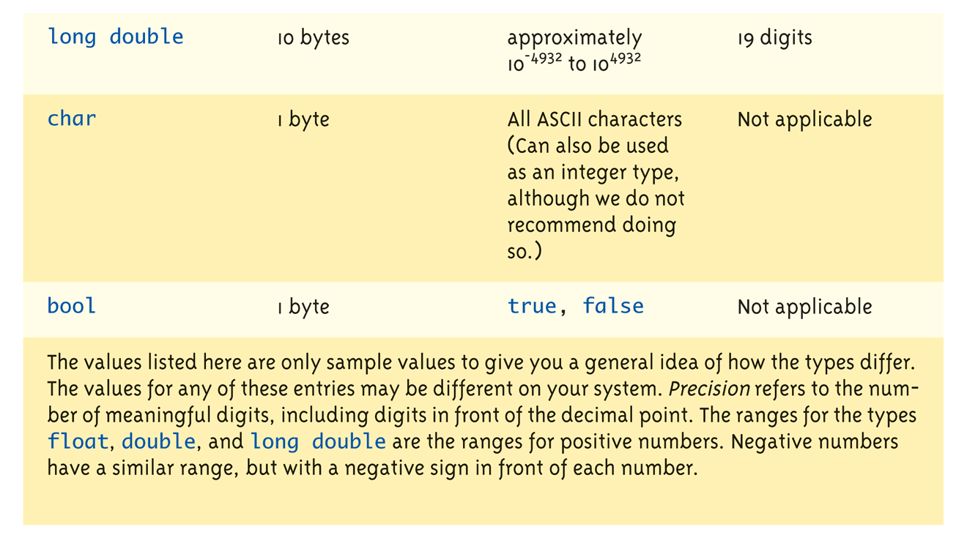
Data Types:
Display 1.2 Simple Types (2 of 2)
Unsigned Version: unsigned int, unsigned long
Copyright © 2008 Pearson Addison-Wesley. All rights reserved.
1-<number>
Notes:
Char may be treated as an integer type to save space.

Slide 12
Assigning Data
Initializing data in declaration statement
  Results "undefined" if you don’t!
    int myValue = 0;
    int count = 0, distance = 15, factor = 1;
Assigning data during execution
  Lvalues (left-side) & Rvalues (right-side)
    Lvalues must be variables
    Rvalues can be any expression
    Example:
    distance = rate * time;
    Lvalue: "distance"
    Rvalue: "rate * time"
Copyright © 2008 Pearson Addison-Wesley. All rights reserved.
1-<number>

Slide 13
Assigning Data: Tips
All the initial values can be assigned in one function
An assignment statement can be an expression on the right-hand side. Not Recommended.
myDistance = (yourDistance = 15); //not recommended
myDistance = yourDistance = 15; //not recommended
Pitfall: Uninitialized Variables
desiredNumber = minimumNumber + 10; //uninitialized variables?
How to Guard your Input Parameters?
  Check input parameters before using them
1-<number>
Notes:
We may use an assignment statement as an expression on the right-hand side. But this is not recommended.

Slide 14
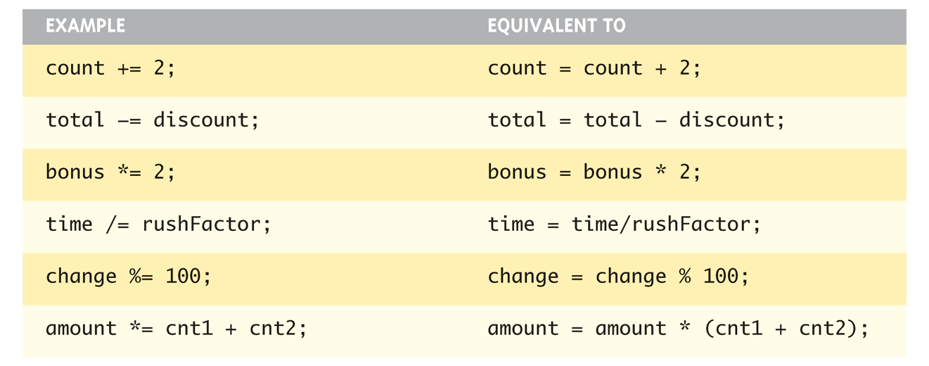
Assigning Data: Shorthand Notations
Display, page 14
Variable Operator = Expression
Copyright © 2008 Pearson Addison-Wesley. All rights reserved.
1-<number>

Slide 15
Data Assignment Rules
Compatibility of Data Assignments
  Type mismatches
    General Rule: Cannot place value of one type into variable of another type
  intVar = 2.99; // 2 is assigned to intVar!
    Only integer part "fits", so that’s all that goes
    Called "implicit" or "automatic type conversion"
  You can assign int values to double variables
    double doubleVariable;
    doubleVariable = 2;
  Literals
    2, 5.75, "Z", "Hello World"
    Considered "constants": can’t change in program
Copyright © 2008 Pearson Addison-Wesley. All rights reserved.
1-<number>
Notes:
You can assign int values to double variables
You may store 25 to a variable of type char; but this is not recommended!
Integer and bool can be assigned to each other; this is a poor style.

Slide 16
Literal Data
Literals: Names for specific values
  Examples:
    2 // Literal constant int
    5.75 // Literal constant double
    "Z" // Literal constant char
    "Hello World" // Literal constant string
Cannot change values during execution
Called "literals" because you "literally typed"
them in your program!
Copyright © 2008 Pearson Addison-Wesley. All rights reserved.
1-<number>

Slide 17
Escape Sequences
"Extend" character set
Backslash, \ preceding a character
  Instructs compiler: a special "escape
  character" is coming
  Following character treated as
  "escape sequence char"
  Display 1.3 next slide
Copyright © 2008 Pearson Addison-Wesley. All rights reserved.
1-<number>

Slide 18
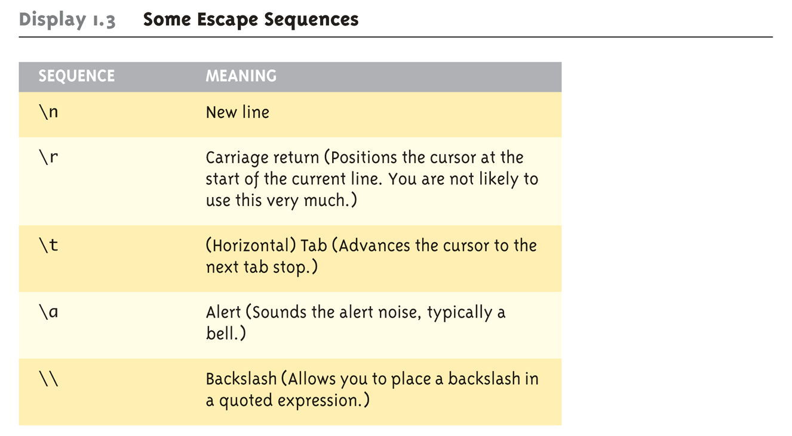
Display 1.3
Some Escape Sequences (1 of 2)
Copyright © 2008 Pearson Addison-Wesley. All rights reserved.
1-<number>

Slide 19
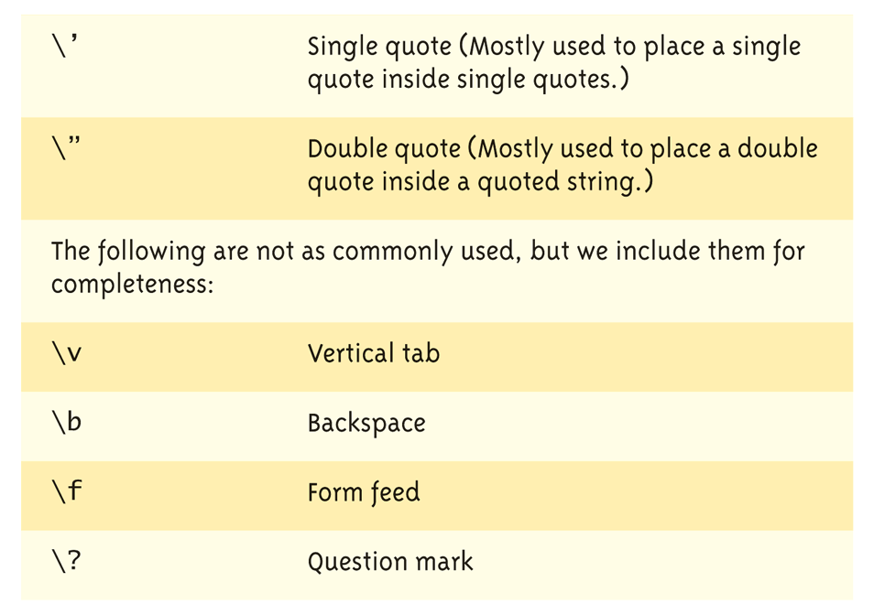
Display 1.3
Some Escape Sequences (2 of 2)
Copyright © 2008 Pearson Addison-Wesley. All rights reserved.
1-<number>

Slide 20
Constants
Naming your constants
  Literal constants are "OK", but provide
  little meaning
    e.g., seeing 24 in a pgm, tells nothing about
    what it represents
Use named constants instead
  Meaningful name to represent data
  const int NUMBER_OF_STUDENTS = 24;
  const int BRANCH_COUNT = 10, WINDOW_COUNT = 10; //not recommended, a separate line is clearer.
    Called a "declared constant" or "named constant"
    Now use it’s name wherever needed in program
    Added benefit: changes to value result in one fix
1-<number>

Slide 21
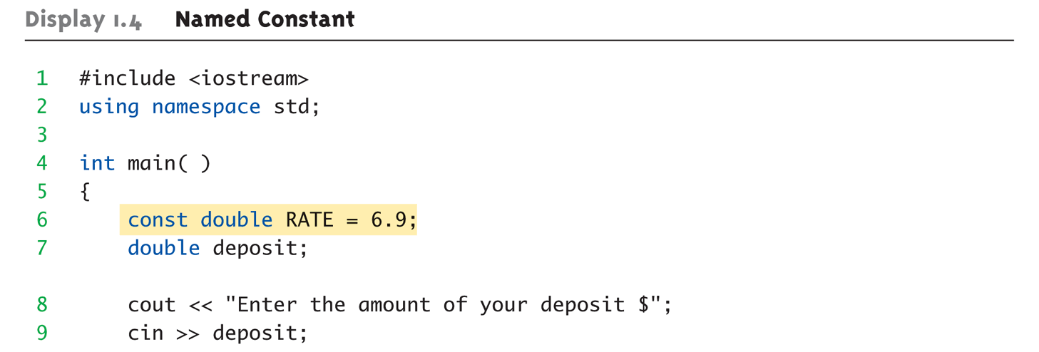
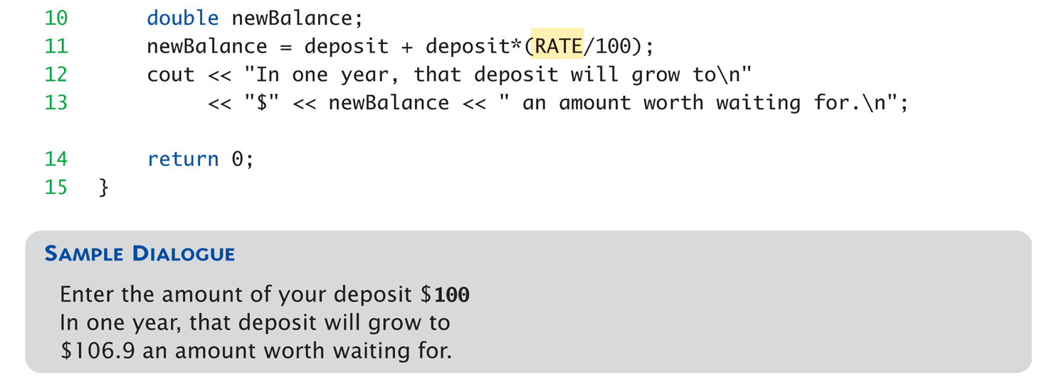
Display 1.4 Named Constant
1-<number>
Notes:
rate.cpp

Slide 22
Summary
C++ is case-sensitive
Use meaningful names
  For variables and constants
Variables must be declared before use
  Should also be initialized
Use care in numeric manipulation
  Precision, parentheses, order of operations
#include C++ libraries as needed
Copyright © 2008 Pearson Addison-Wesley. All rights reserved.
1-<number>

Slide 23
Arithmetic Precision
Precision of Calculations
  VERY important consideration!
    Expressions in C++ might not evaluate as
    you’d "expect"!
  "Highest-order operand" determines type
  of arithmetic "precision" performed
  Common pitfall!
Copyright © 2008 Pearson Addison-Wesley. All rights reserved.
1-<number>

Slide 24
Arithmetic Precision Examples
Examples:
  17 / 5 evaluates to 3 in C++!
    Both operands are integers
    Integer division is performed!
  17.0 / 5 equals 3.4 in C++!
    Highest-order operand is "double type"
    Double "precision" division is performed!
  int intVar1 =1, intVar2=2;
  intVar1 / intVar2;
    Performs integer division!
    Result: 0!
Copyright © 2008 Pearson Addison-Wesley. All rights reserved.
1-<number>

Slide 25
Individual Arithmetic Precision
Calculations done "one-by-one"
  1 / 2 / 3.0 / 4 performs 3 separate divisions.
    First→ 1 / 2 equals 0
    Then→ 0 / 3.0 equals 0.0
    Then→ 0.0 / 4 equals 0.0!
So not necessarily sufficient to change
just "one operand" in a large expression
  Must keep in mind all individual calculations
  that will be performed during evaluation!
Copyright © 2008 Pearson Addison-Wesley. All rights reserved.
1-<number>

Slide 26
Type Casting
Casting for Variables
  Can add ".0" to literals to force precision
  arithmetic, but what about variables?
    We can’t use "myInt.0"!
  static_cast<double>intVar
  Explicitly "casts" or "converts" intVar to
  double type
    Result of conversion is then used
    Example expression:
    doubleVar = static_cast<double>intVar1 / intVar2;
      Casting forces double-precision division to take place
      among two integer variables!
Copyright © 2008 Pearson Addison-Wesley. All rights reserved.
1-<number>

Slide 27
Type Casting
Two types
  Implicit—also called "Automatic"
    Done FOR you, automatically
    17 / 5.5
    This expression causes an "implicit type cast" to
    take place, casting the 17 → 17.0
  Explicit type conversion
    Programmer specifies conversion with cast operator
    (double)17 / 5.5
    Same expression as above, using explicit cast
    (double)myInt / myDouble
    More typical use; cast operator on variable
Copyright © 2008 Pearson Addison-Wesley. All rights reserved.
1-<number>

Slide 28
Shorthand Operators
Increment & Decrement Operators
  Just short-hand notation
  Increment operator, ++
  intVar++; is equivalent to
  intVar = intVar + 1;
  Decrement operator, --
  intVar--; is equivalent to
  intVar = intVar – 1;
Copyright © 2008 Pearson Addison-Wesley. All rights reserved.
1-<number>

Slide 29
Shorthand Operators: Two Options
Post-Increment
intVar++
  Uses current value of variable, THEN increments it
Pre-Increment
++intVar
  Increments variable first, THEN uses new value
"Use" is defined as whatever "context"
variable is currently in
No difference if "alone" in statement:
intVar++; and ++intVar; → identical result
Copyright © 2008 Pearson Addison-Wesley. All rights reserved.
1-<number>

Slide 30
Post-Increment in Action
Post-Increment in Expressions:
int n = 2,
valueProduced;
valueProduced = 2 * (n++);
cout << valueProduced << endl;
cout << n << endl;
  This code segment produces the output:
  4
  3
  Since post-increment was used
Copyright © 2008 Pearson Addison-Wesley. All rights reserved.
1-<number>

Slide 31
Pre-Increment in Action
Now using Pre-increment:
int n = 2,
valueProduced;
valueProduced = 2 * (++n);
cout << valueProduced << endl;
cout << n << endl;
  This code segment produces the output:
  6
  3
  Because pre-increment was used
Copyright © 2008 Pearson Addison-Wesley. All rights reserved.
1-<number>

Slide 32
Console Input/Output
I/O objects cin, cout, cerr
Defined in the C++ library called
<iostream>
Must have these lines (called pre-
processor directives) near start of file:
  #include <iostream>
  using namespace std;
  Tells C++ to use appropriate library so we can
  use the I/O objects cin, cout, cerr
Copyright © 2008 Pearson Addison-Wesley. All rights reserved.
1-<number>

Slide 33
Console Output
What can be outputted?
  Any data can be outputted to display screen
    Variables
    Constants
    Literals
    Expressions (which can include all of above)
  cout << numberOfGames << " games played.";
  2 values are outputted:
  "value" of variable numberOfGames,
  literal string " games played."
Cascading: multiple values in one cout
Copyright © 2008 Pearson Addison-Wesley. All rights reserved.
1-<number>

Slide 34
Separating Lines of Output
New lines in output
  Recall: "\n" is escape sequence for the
  char "newline"
A second method: object endl
Examples:
  cout << "Hello World\n";
    Sends string "Hello World" to display, & escape
    sequence "\n", skipping to next line
  cout << "Hello World" << endl;
    Same result as above
Copyright © 2008 Pearson Addison-Wesley. All rights reserved.
1-<number>

Slide 35
Formatting Output
Formatting numeric values for output
  Values may not display as you’d expect!
  cout << "The price is $" << price << endl;
    If price (declared double) has value 78.5, you
    might get:
      The price is $78.500000 or:
      The price is $78.5
We must explicitly tell C++ how to output numbers in our programs!
Copyright © 2008 Pearson Addison-Wesley. All rights reserved.
1-<number>

Slide 36
Formatting Numbers
"Magic Formula" to force decimal sizes:
cout.setf(ios::fixed);
cout.setf(ios::showpoint);
cout.precision(2);
These stmts force all future cout’ed values:
  To have exactly two digits after the decimal place
  Example:
  cout << "The price is $" << price << endl;
    Now results in the following:
    The price is $78.50
Can modify precision "as you go" as well!
Copyright © 2008 Pearson Addison-Wesley. All rights reserved.
1-<number>

Slide 37
Error Output
Output with cerr
  cerr works same as cout
  Provides mechanism for distinguishing
  between regular output and error output
Re-direct output streams
  Most systems allow cout and cerr to be
  "redirected" to other devices
    e.g., line printer, output file, error console, etc.
Copyright © 2008 Pearson Addison-Wesley. All rights reserved.
1-<number>

Slide 38
Input Using cin
cin for input, cout for output
Differences:
  ">>" (extraction operator) points opposite
    Think of it as "pointing toward where the data goes"
  Object name "cin" used instead of "cout"
  No literals allowed for cin
    Must input "to a variable"
cin >> num;
  Waits on-screen for keyboard entry
  Value entered at keyboard is "assigned" to num
Copyright © 2008 Pearson Addison-Wesley. All rights reserved.
1-<number>

Slide 39
Prompting for Input: cin and cout
Always "prompt" user for input
cout << "Enter number of dragons: ";
cin >> numOfDragons;
  Note no "\n" in cout. Prompt "waits" on same
  line for keyboard input as follows:
    Enter number of dragons: ____
    Underscore above denotes where keyboard entry
    is made
Every cin should have cout prompt
  Maximizes user-friendly input/output
Copyright © 2008 Pearson Addison-Wesley. All rights reserved.
1-<number>

Slide 40
Program Style
Bottom-line: Make programs easy to read and modify
Comments, two methods:
  // Two slashes indicate entire line is to be ignored
  /*Delimiters indicates everything between is ignored*/
  Both methods commonly used
Identifier naming
  ALL_CAPS for constants
  lowerToUpper for variables
  Most important: MEANINGFUL NAMES!
Copyright © 2008 Pearson Addison-Wesley. All rights reserved.
1-<number>

Slide 41
Libraries
C++ Standard Libraries
#include <Library_Name>
  Directive to "add" contents of library file to
  your program
  Called "preprocessor directive"
    Executes before compiler, and simply "copies"
    library file into your program file
C++ has many libraries
  Input/output, math, strings, etc.
Copyright © 2008 Pearson Addison-Wesley. All rights reserved.
1-<number>

Slide 42
Namespaces
Namespaces defined:
  Collection of name definitions
For now: interested in namespace "std"
  Has all standard library definitions we need
Examples:
#include <iostream>
using namespace std;
    Includes entire standard library of name definitions
#include <iostream>using std::cin;
using std::cout;
    Can specify just the objects we want
Copyright © 2008 Pearson Addison-Wesley. All rights reserved.
1-<number>

Slide 43
Summary
Object cout
  Used for console output
Object cin
  Used for console input
Object cerr
  Used for error messages
Use comments to aid understanding of
your program
  Do not overcomment
Copyright © 2008 Pearson Addison-Wesley. All rights reserved.
1-<number>

